Slide 1
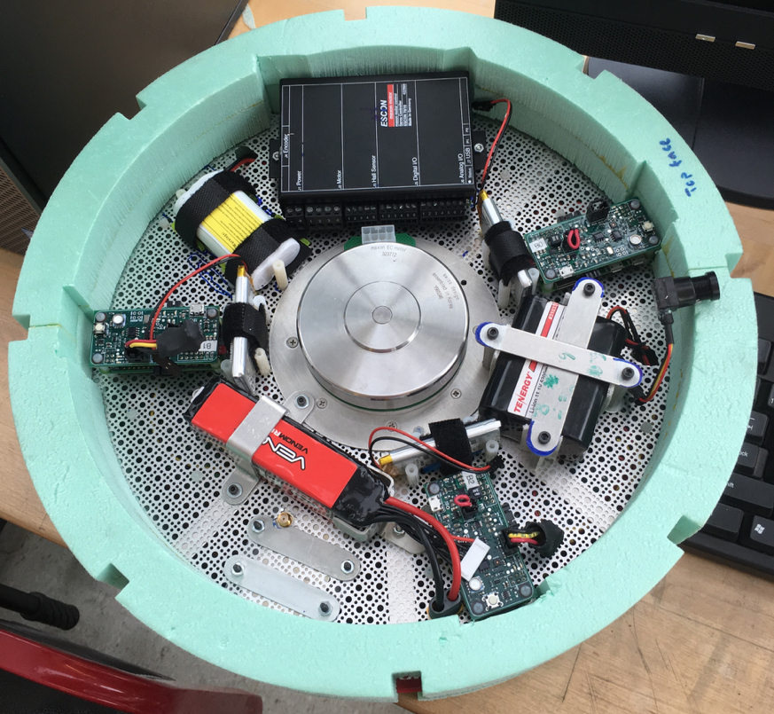
The Chassis
Improved ease of access to electronics
Reduced rotational moment of inertia
Less power will be required of the motor to stabilize the platform
Reduced weight
Actual chassis is 77% lighter than last year’s team
Foam adds buoyancy and impact protection

Slide 2
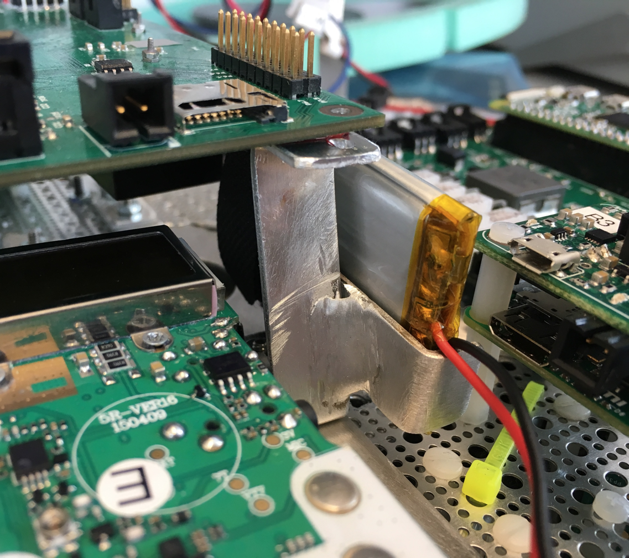
The Chassis (continued)
Electronics are hard-mounted to the metal mesh
More secure than foam mount
Heat can be easily transferred between hot and cold electronics, to prevent temperature extremes
Electronics are organized in a way that is balanced and reduces wire length

Slide 3
Chassis Requirements
Important Parameters:
Thermal Protection
Chassis must protect Electronics from extreme temperatures at both ends of the spectrum
Electronics Mounting Security
Chassis must keep electronics securely mounted in the event of violent wind shear or impact
Thermal Distribution
Chassis must transfer heat away from hot electronics and toward cold electronics
Weight
Weight must be reduced to ensure long flight times and high altitudes reached
Weight Distribution (weight balance)
Chassis must be balanced, to ensure platform is level in flight
Rotational Moment of Inertia
The chassis must minimize this to reduce the power needed to keep the platform stable
Radiation Protection
Chassis must shield Electronics from radiation to prevent damage and flipped bits
Ease of Access to Electronics
Electronics must be easy to access and troubleshoot prior to launch

Slide 4
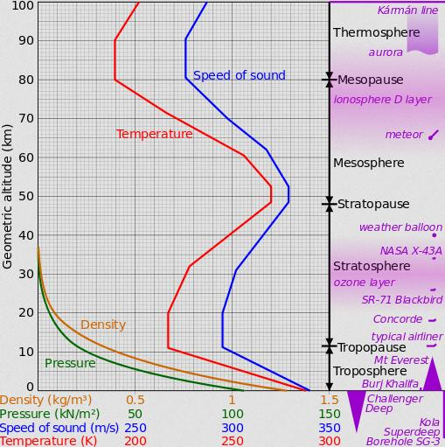
The Importance of Thermal Modeling
Many external conditions the HAB goes through are not experienced on earth, and therefore, the thermal performance of the HAB at altitude cannot be expected to match that here on Earth.
Extremely low air density
Since the air is so “thin” at 100,000ft, heat transfer by convection is severely diminished
This makes adequate heat rejection from the platform very difficult
Extreme cold air temperatures
The lowest point on the US standard temperature that the HAB will experience is -56°C
High Levels of Incident Solar Radiation
There is very little atmosphere above the HAB to protect it.

Slide 5
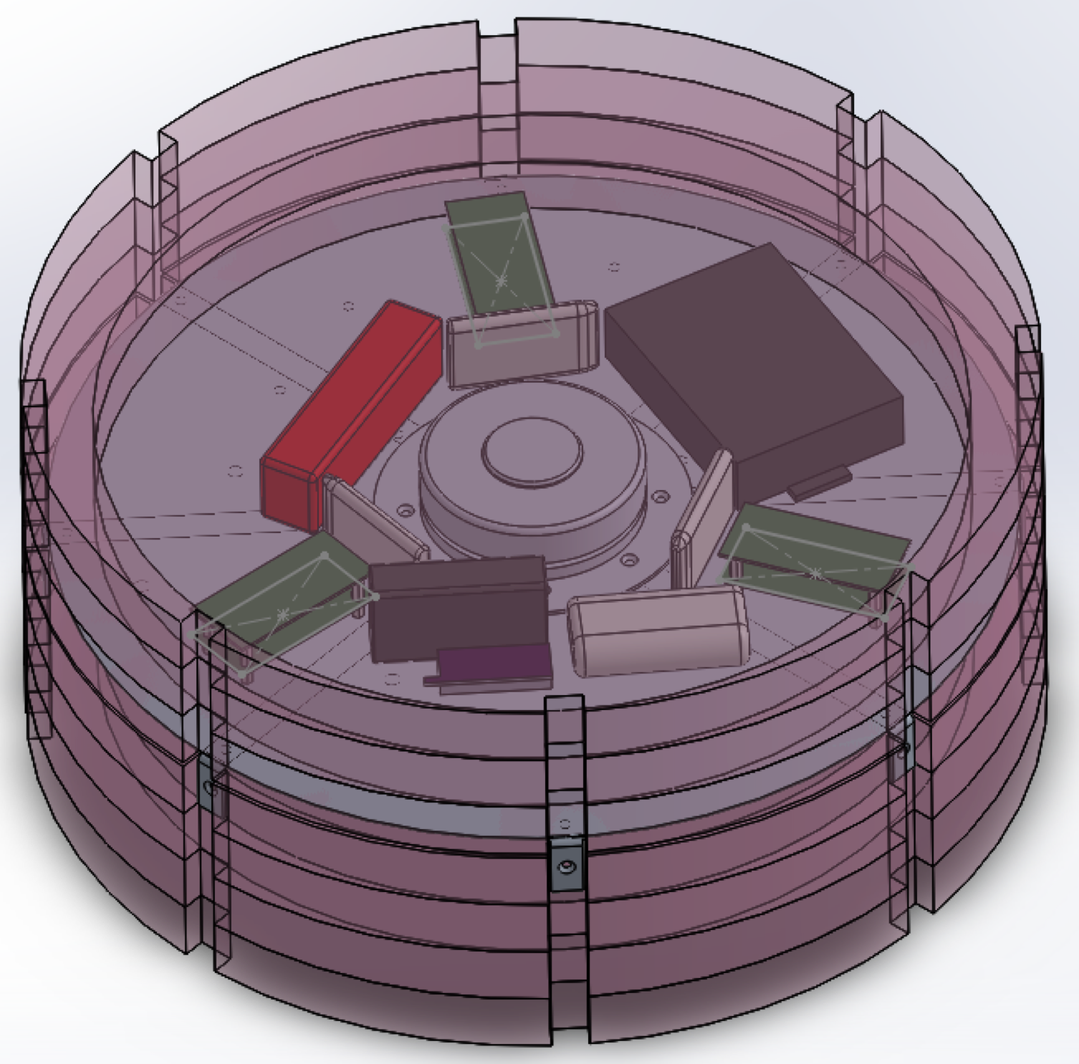
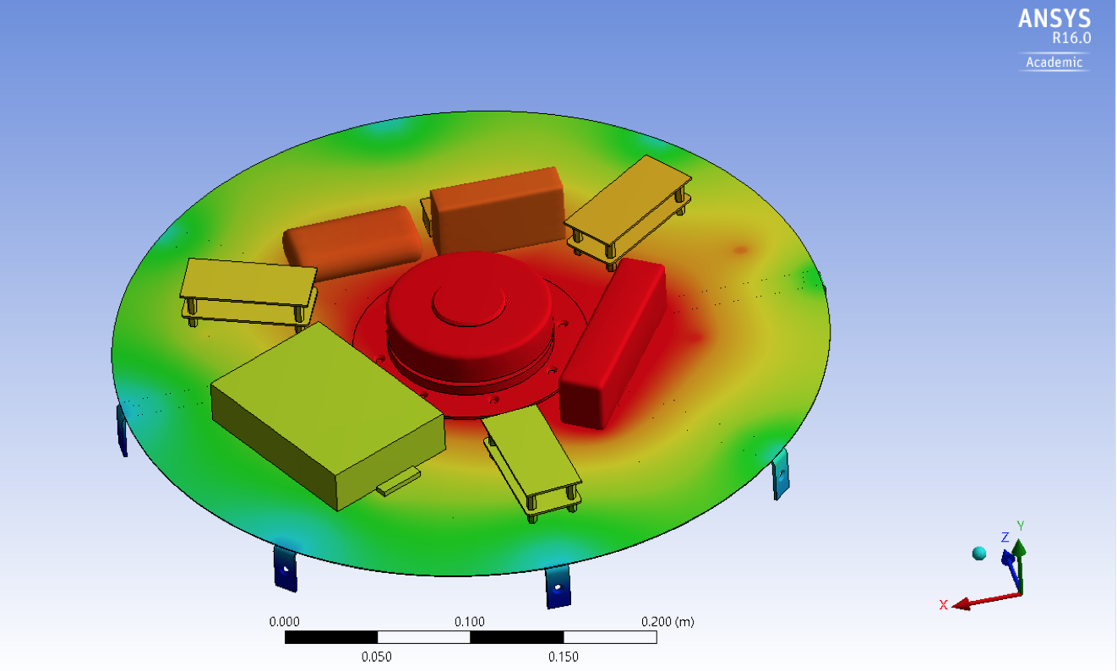
Thermal Modeling Strategy
HAB was CAD modeled in Solidworks
Model was imported into ANSYS and the heat distribution throughout the chassis and electronics was simulated
Hand calculations were performed to check results
Matlab/Simulink/Simscape are being used to determine the high-level heat transfer in and out of the platform

Slide 6
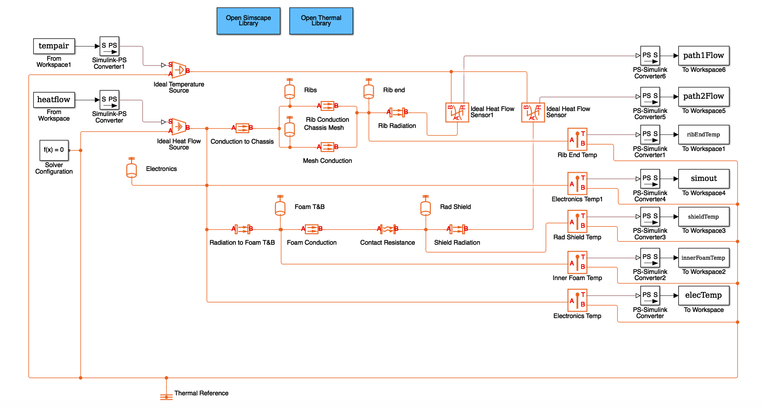
Simscape Simulation
A detailed thermal circuit of the entire HAB was drawn up
A Simscape thermal circuit was created.
Final results for the steady state at-altitude simulation are waiting on a final heat generation estimates.

Slide 7
Future Simulations to Run
I will attempt to run as many of these simulations as I can run before my attention needs to be diverted to building and preparing the HAB for launch.
Run SS worst case hot (max radiation, insulation and heat generation)
Run SS worst case cold (min radiation, insulation and heat generation)
Run SS best guess
Compare sensor data to SS best guess and make necessary adjustments to sim
Calculate convection coefficients for:
Natural convection inside the HAB
Forced convection outside the HAB
Run SS best guess at 10,000 ft increments including convection
Create and run transient sim
(best guess, worst case high and low)
Run transient sim with previous teams conditions and compare results

